Slide 1
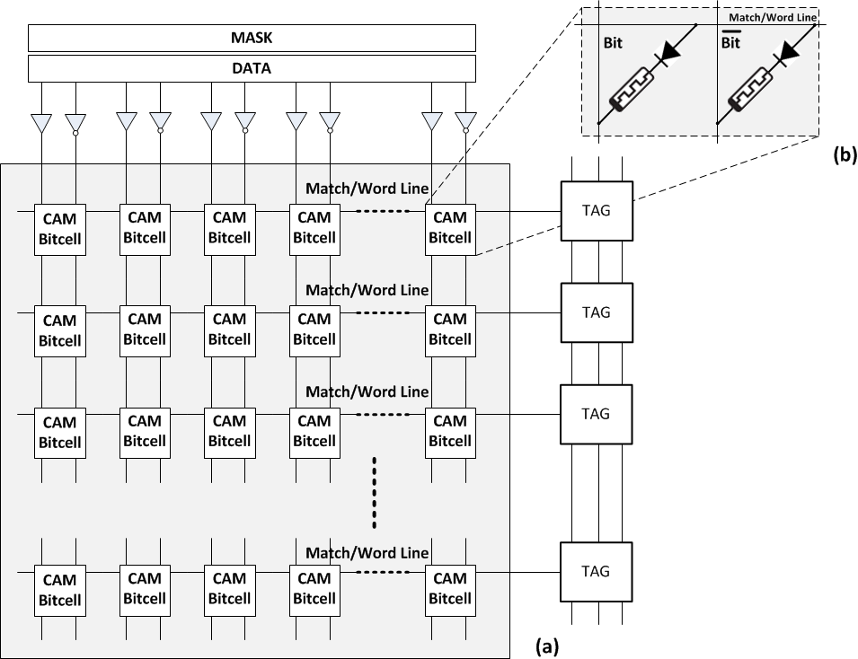
ReCAM – Top Level View

Slide 2
ReCAM – Top Level View

Slide 3


Slide 4


TAG Logic (Light)
RST
PRECH
Precharge
Latch
Match/Word Line
RST
write
(a)
(b)
(c)
FIRST_TAG
MISMATCH

Slide 5
Original
Blocks: A B C D A
LBAs: 0 1 2 3 4
Data
LBA
SHA-1
Conversion
Table
A
B
C
D
2
1
1
1
0
1
2
3
4
P(A)
P(B)
P(C)
P(D)
P(A)
Address Decoder
CNT
HASH

Slide 6
Original
Blocks: A B C D A
LBAs: 0 1 2 3 4
Data
LBA
Address
Translation
Table
PA(A)
PA(B)
PA(C)
PA(D)
A
B
C
D
0
1
2
3
4
PA(A)
PA(B)
PA(C)
PA(D)
PA(A)
Physical
Address
Data Blocks
Physical
Address
LBA

Slide 7
Storage
LBA
A
…
A
B
C
x
…
y
y+1
y+2
Logical Layer
Physical Layer
Address
Translation
Table
Chunk
Index
Storage
A
B
C
Hash(A)
….
Hash(B)
…..
Hash(C)
PA(A)
…
PA(B)
…
PA(C)
2
…
1
…
1
x
y
y+1
y+2
PA(A)
PA(A)
PA(B)
PA(C)
Address
Decoder
Data Blocks
Fingerprint
Physical
Address
CNT
LBA
Physical
Address

Slide 8
Storage
LBA
A
…
A
B
C
x
…
y
y+1
y+2
Logical Layer
Physical Layer
Address
Translation
Table
Storage
PA(A)
PA(B)
PA(C)
A
B
C
x
y
y+1
y+2
PA(A)
PA(A)
PA(B)
PA(C)
Physical
Address
Data Blocks
LBA
Physical
Address

Slide 9
Storage
LBA
A
…
A
B
C
x
…
y
y+1
y+2
Logical Layer
Physical Layer
ReCAM
Address
Translation
Table
Storage (HDD)
PA(A)
PA(B)
PA(C)
A
B
C
x
y
y+1
y+2
PA(A)
PA(A)
PA(B)
PA(C)
Physical
Address
Data Blocks
LBA
Physical
Address

Slide 10
